Slide 1

Food For Athletes
“I’m completely hooked.” - Lorenzo Neal, ex nfl superstar

Slide 2
Our Mission
“Foods For Athletes, Inc. (FFA) creates innovative formulas and products infused with the finest ingredients from the richest soil in the USA, all designed to provide your body with the minerals and nutrients it needs for optimal health conditions”

Slide 3
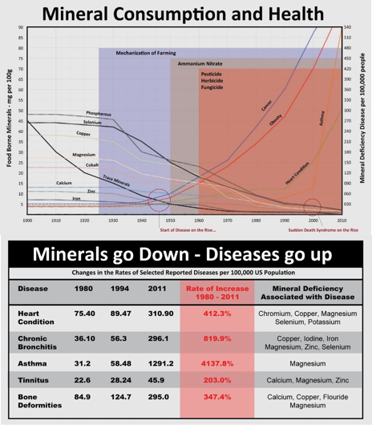
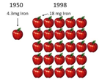
The Problem
Studies show that proper nutrition with minerals and probiotics can help increase energy levels, muscle development, and overall good health. However, Today’s food and beverages no longer provide the nutrients and minerals our bodies require.
Eating what nutritionists call a “balanced diet” with the “right foods” is no longer sufficient to maintain good health. Today's conventional farming methods have resulted in mineral soil depletion, coupled with food additives consisting of chemicals, dyes, sweeteners and preservatives, this resulted in the production of foods containing marginal nutritional value. The population is getting sick due to a lack of minerals which the body needs to achieve optimal health conditions.

Slide 4

The Solution
BlackMP Products uniquely combine organic grade Probiotics, Humic & Fulvic Minerals, Electrolytes, and Alkaline (pH 10) water, to create the most nutritional supplements available today which provide the body with the minerals it needs for an improved immune system and optimal health condition.

Slide 5

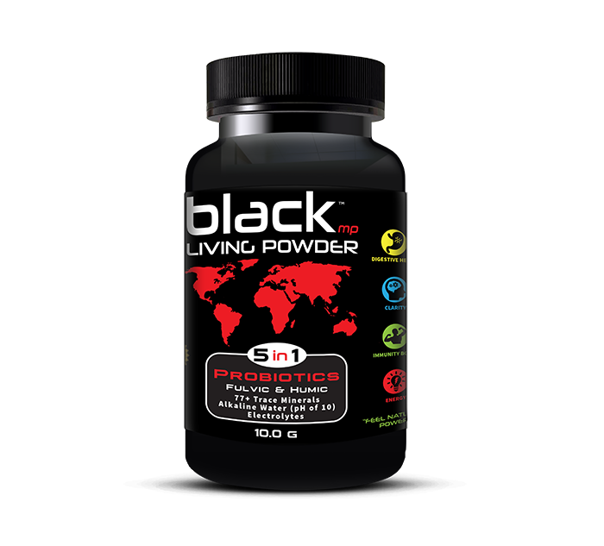
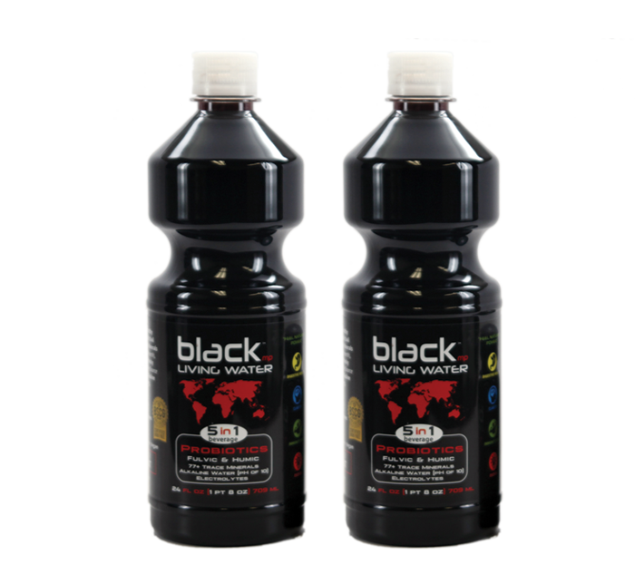
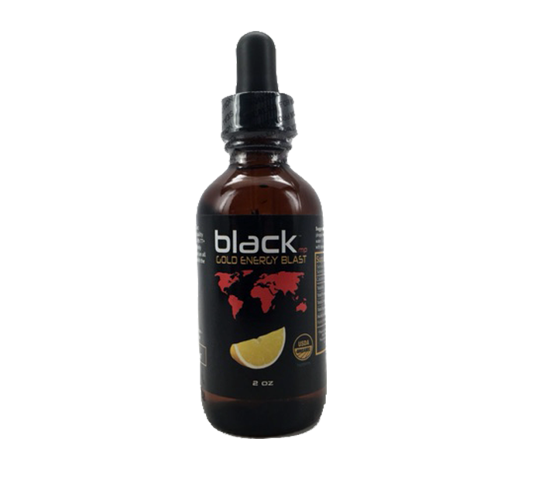
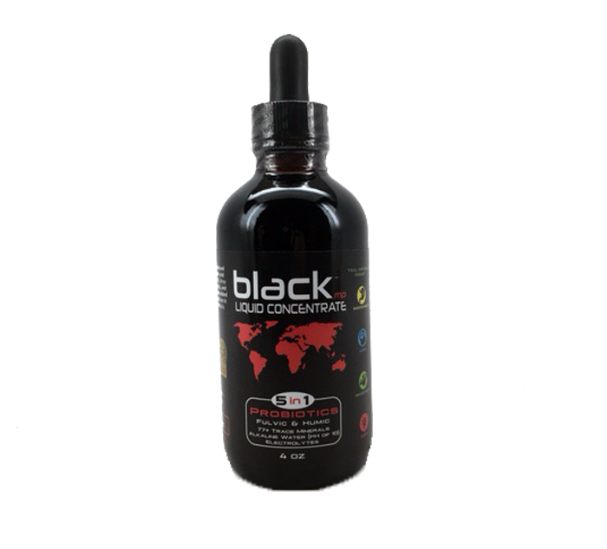


The Solution
BlackMp Product line
Bottled Water
Fat Burner Powder
Original Powder
Energy concentrate
Liquid Concentrate

Slide 6
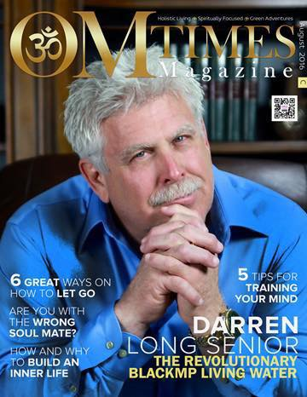
Traction
We are growing fast!
Already selling in more than 200 retail locations and growing
Sold at major national retailers such as Whole Foods – Going Nationwide in 2017.
Contracts are signed with other major distributors such as Kehe Distributors which handles all the Save Mart stores
Received Letters of Intent from various companies wanting to license and/or white-label our formulas and ingredients, also from international distribution companies in Asia and Mexico
Multiple press appearances: Visalia Times Delta & Tulare Advance Register, Front cover of national OM Times magazine, Central Valley Talk Show
Darren Long received a humanitarian award as well signed by the President
of The United States, for his focus on youth sports.
To date, the company generated over $400,000 in sales of the BlackMp products with no paid advertising

Slide 7


Testimonials
See more @ https://blackmp.tech/testimonials/
Ex NFL Player
Olympic medal winner
AMAZon Customer
Loyal Customer
LORenzo neal
Matt lindland
Sylvia Adams
Arturo
“I take BlackMP every day to stay hydrated, mentally clear, and pain free after 16 tough years in the NFL.”
“Since taking Blackmp for over a year now, I feel less stressed, more energized and ready to take on the daily challenges of leading the US Greco-Roman National team."
“My husband and I use this supplement to get that fulvic acid boost and improve overall uptake of nutrients and energy to our body. We will continue to use this supplement as part of our morning routine. Highly recommended!”
“I am a diabetic [and] I cheat all the time. I still only take pills. I went for labs [after] taking … BlackMP. I don’t know if it deserves the credit but both my A1C and Cholesterol were down a lot. My doctor says I’m am doing great. A1C was 6.4 down from 8.8 and cholesterol was down from 500+ to 237. Thank you BlackMP for being responsible for it.”

Slide 8
Market Size
1
“Global Bottled Water is expected to reach $279.65 Billion by 2020”
2
“Soft drinks, sports and energy drinks – $531.3 Billion”
3
“Probiotics Market Worth To Reach $52.34 Billion, Growth At CAGR Of 7.6% Till
2020”
“Global dietary supplements market size was USD 122.08 billion in 2015. Rising awareness towards nutritional enrichment in food & beverage sector is expected to have a significant impact on the market.”
4

Slide 9
Monetization Models
Consumables
Licensing
FFA makes money by selling it’s own consumable products which consist of bottled water, powders and concentrates.
In addition to it’s current BlackMp product line, the company is working on additional lines of products it will be offering shortly for exports.
The profit margin on these products are high due to a low COGS and high product mark up we can demand due to our USDA organic certification.
FFA has been approached by many companies looking to enter licensing agreements and private label agreements in order to use our formulas to add to their own existing products.
From coffee companies, to CBD companies, our ingredients can be a great additions to a wide range of products giving us an tremendous opportunity to scale.
We are able to capitalize on these opportunities by charging licensing fees and royalties for these companies to use our formulas and ingredients.
This model results in high cash flow and minimized risk as we are giving customers the rights to our formulas for negotiated fees.

Slide 10
Marketing & Distribution
Digital
Distributors
Partnerships
expos
Direct contact to increase our presence in more locations through national retailers, convenience, grocery, Drug, and Nutritional Stores.
Optimize our website performance. Increase our reach on social media and increase customer engagement.
Invest profitably in digital advertising channels such as Facebook Ads, YouTube Ads and Google Ads.
Increase our Amazon Sales by increasing visibility through our rankings.
Licensing deals, private label for the formulas and ingredients.
Increase deal flow for joint-venture and licensing opportunities by attending national expos.

Slide 11
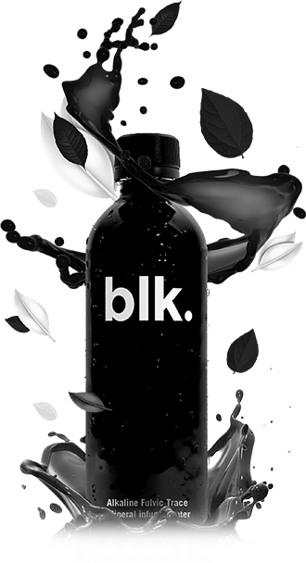
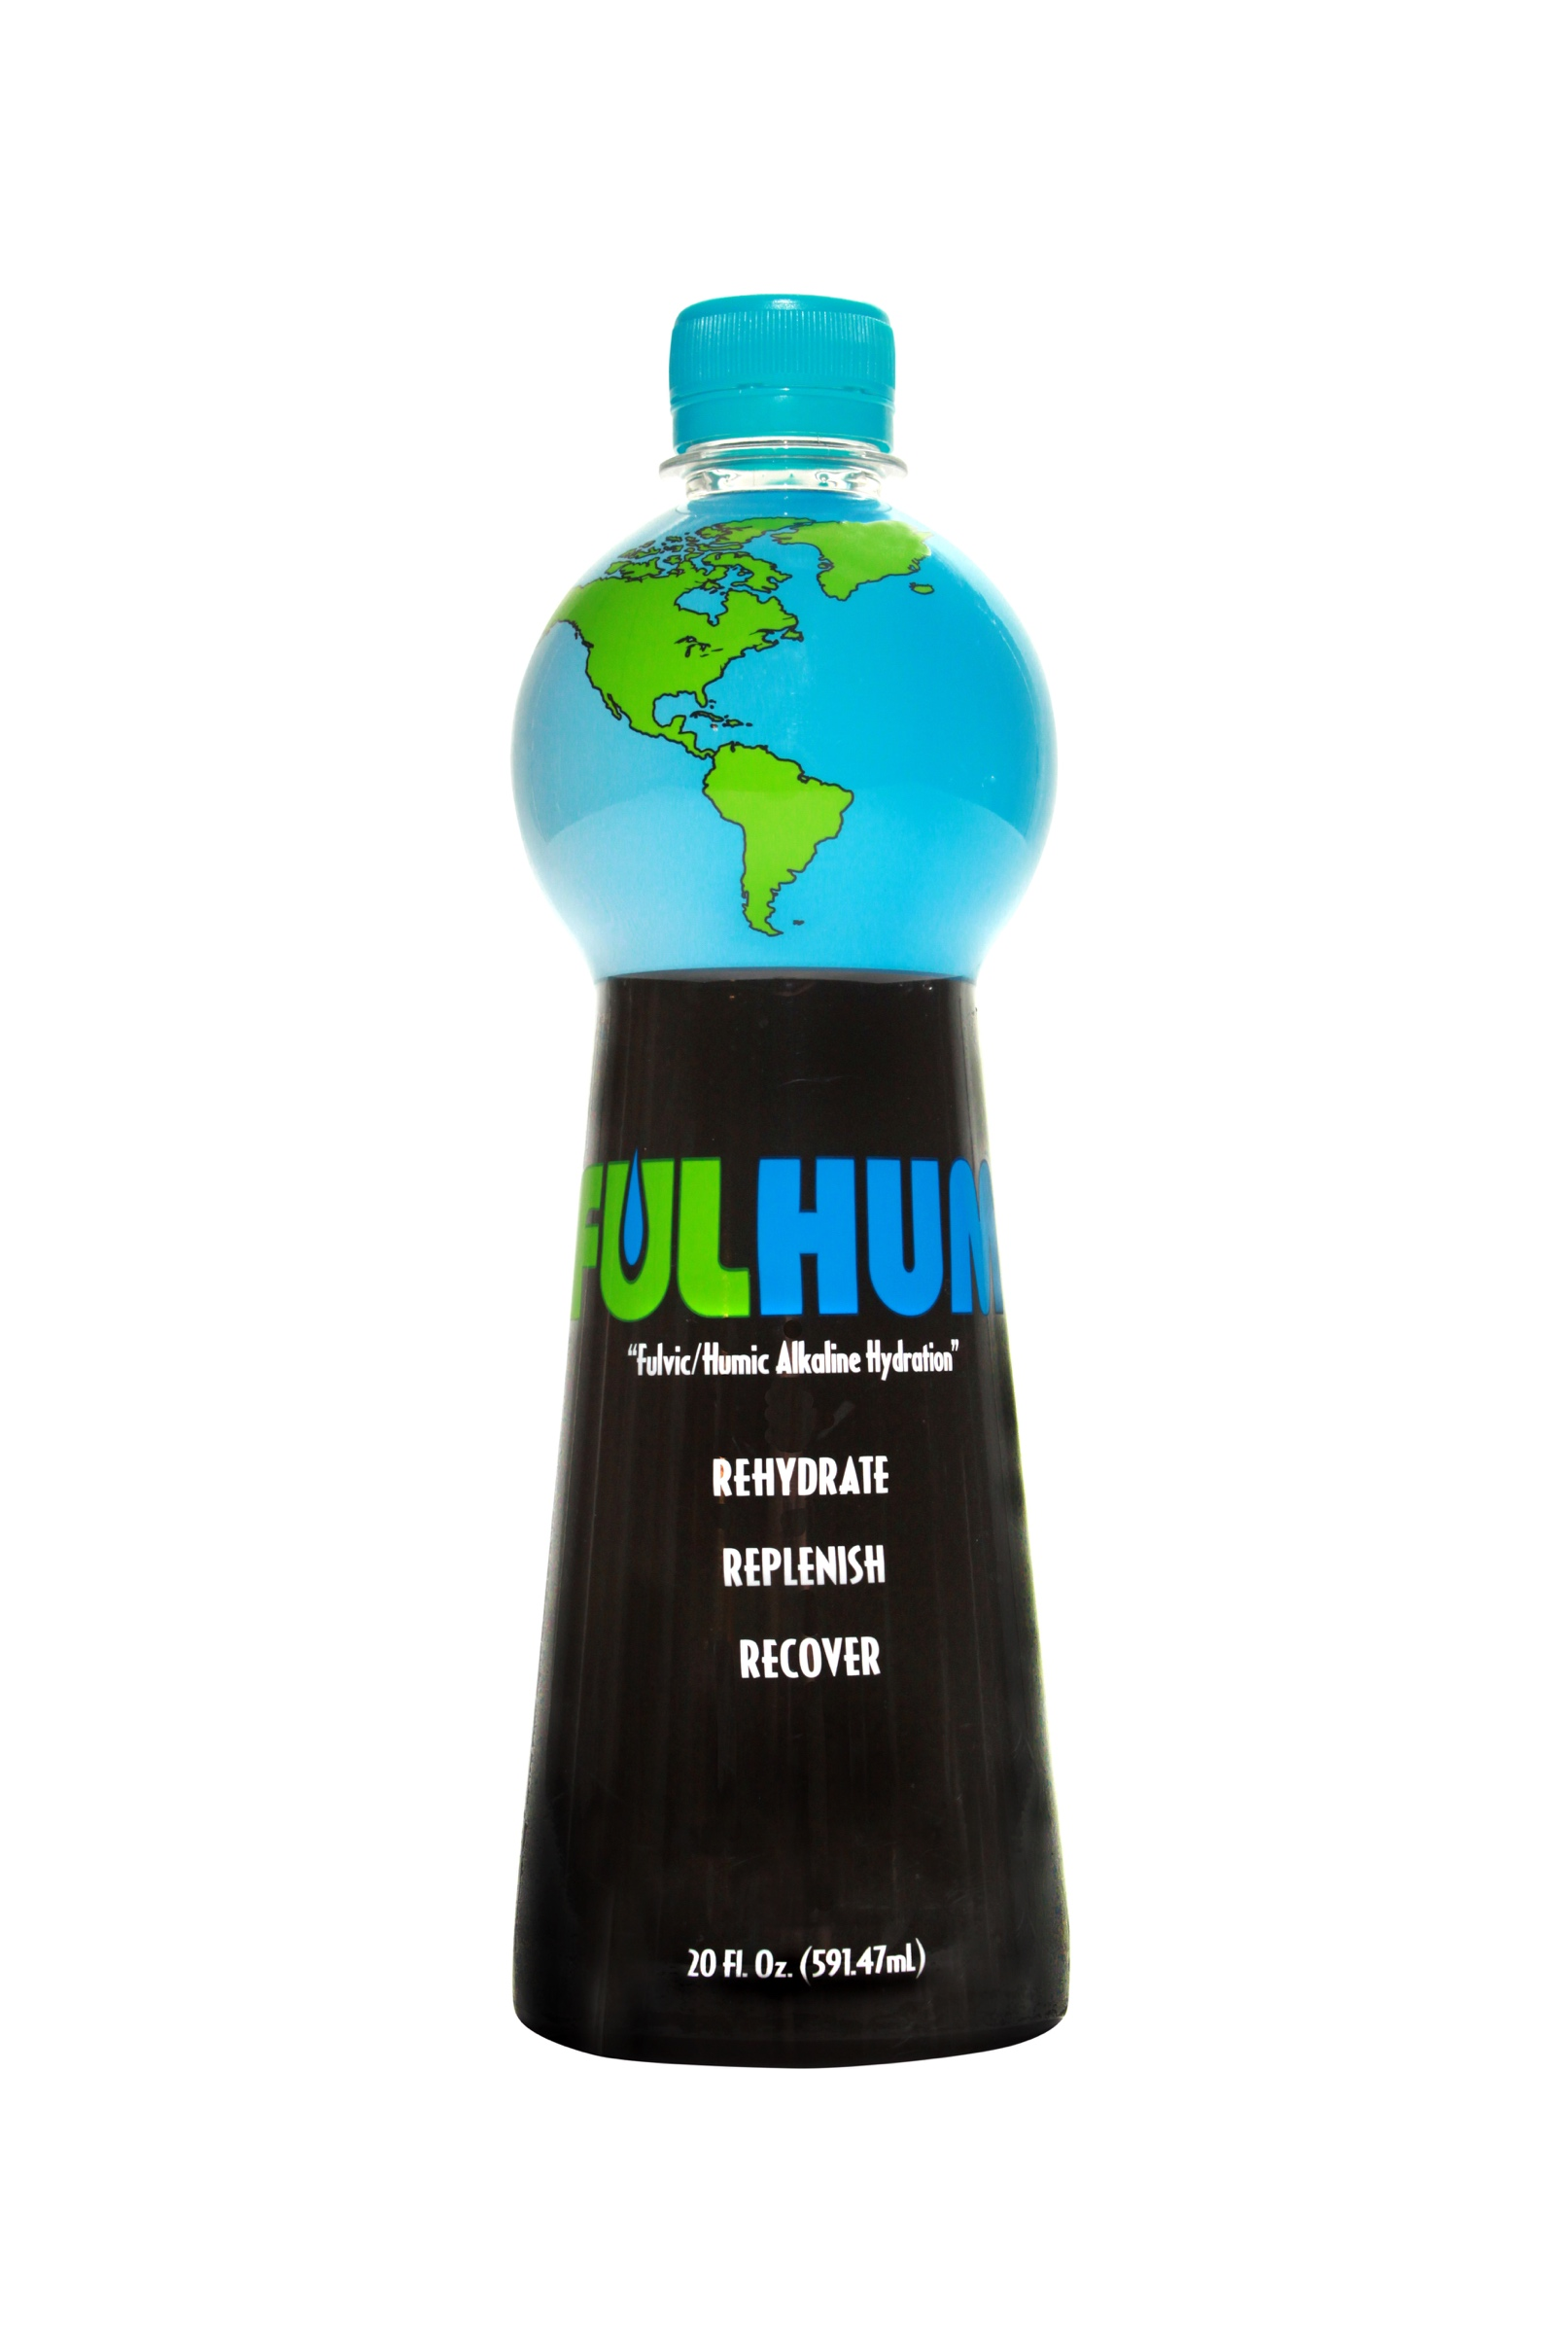
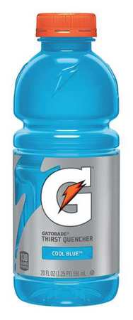
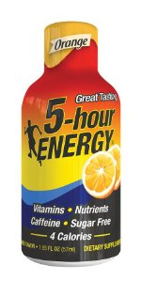
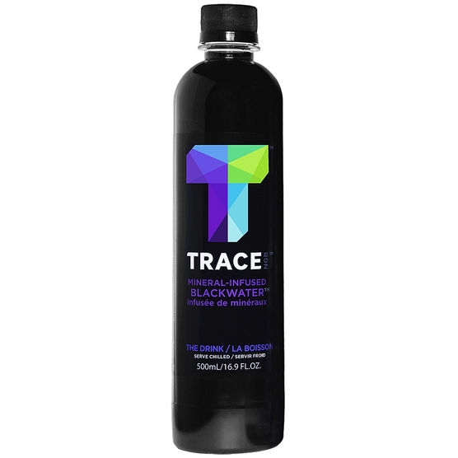
Competition
TRACE Blackwater
BLK.
Fulhum
Gatorade
5-Hour Energy

Slide 12

How are we better?
Probiotics
USDA Certified
In addition to the Humic and Fulvic minerals, our products also contain probiotics, which are known for their tremendous health benefits and positive impact on the immune system.
Our products have been USDA certified, which gives our company credibility in the market place and peace of mind to our customers.
100% Organic
all-in-1 Powder
All our ingredients are 100% organic, taken directly from the soil with no sugars, no artificial flavors,, no chemicals, no preservatifs, no artificial PH levels, and no calories.
While our competitors offer bottled water we also offer our popular “All in 1” powder which allows consumers to create their own water or add to other beverages.
This powder also contains
Fulvic and Humic minerals (77+ trace minerals) as well as SBO (Soil Based Organism) probiotics, all USDA Organic Certified and with a pH of 10

Slide 13
Milestones
Initial research and studies of the combination of humic and fulvic trace minerals with probiotics applicable to human consumption for Foods For Athletes/Blackmp.
2012 – Idea inception
1
Flagship Blackmp Powder concentrate and ready to drink Blackmp Living Water is
Launched to the marketplace.
2
2013 – Blackmp launch

Slide 14
FFA/Blackmp acquires its first professional athlete endorsements: Lorenzo Neal NFL,
Robert Oberst top three Worlds Strongest men competitor, Daniel Valdivia up an coming
professional boxer and a USA Olympic Wrestling coach Matt Lindland to name a few.
Product endorsements
3
FFA/Blackmp starts its website and Amazon account to launch digital sales campaigns.
4
2014 - Digital presence
FFA/Blackmp secures a major bottled water contract with bottling company in Colorado.
That then leads to a contract to test market bottled water in 4 states and 18 locations with
Whole Foods. Nationwide contract coming this year 2017.
2015 – First major contracts
5

Slide 15
FFA/Blackmp attends Expos to spread it’s message. This
has opened up many new opportunities, such as new contracts with Save Mart and Lucky grocery store chains.
6
2016 – distribution expension
The next 6-12 months has the potential, with proper funding, to explode on the distribution scene. Contracts with Statewide, UNFI and Kehe in the domestic market. An Export deal is on the table to get into Mexico and China, through private labeling. As well as white labeling for other companies like EVR and CBD Wellness Depot.
7
Next 12 months

Slide 16
Meet the team
Darren long
Darren long jr.
Brian Martino
Founder & president
Co-founder & Jr. Vice President
Cfo & treasurer
Former NFL professional player and USFL Tight End and 3x All American. BS Degree in Bio-Chemistry and Nutrition from Long Beach State University and over 25 year of experience in the Agricultural Industry.
In his youth, he contributed to the success of the family business, "Sequoia Ag", which helps farmers cultivate nutrient dense healthy soils. Other accomplishments include helping to develop a multi-level marketing company, developing the first ever USDA organic probiotics for human consumption on the market, and creating other unique organic products ranging from beverages to skin creams. These efforts have provided him with an extensive background in product development, company branding and marketing.
Seasoned entrepreneur with successful careers in business and finance including ownership of a property investment company, Martinho Investments, Brian Martinho Construction, Inc., and previously Martinho’s Mini Mart, Car Wash, Old Firehouse Pizzeria, and as an AIG/Valic Financial Advisor.
Robert j lewis jr.
Steve ferrone
Coo
Managing partner
Decades of experience in business. Vice President of Coastal Earthmovers, a General Engineering firm with recent annual gross receipts exceeding $40 million dollars. He is a Business School graduate from the University of Wisconsin-Milwaukee.
Veteran marketing and sales executive responsible for crafting and spearheading record breaking regional and national brand initiatives and sales for several multi-national companies. He brings cross-industry experience from the legal, financial services, pharmaceutical and fitness sectors combined with a multi-faceted skill set which includes strategic planning and organization, brand and product development, team building and business management.

Slide 17
Financial Projections
 | Year 1 | Year 2 | Year 3 | Year 4 | Year 5
Total Sales | $7,609,547 | $16,167,941 | $31,532,709 | $40,710,855 | $47,102,624
Net Cash Flow | $1,191,233 | $3,353,886 | $6,866,586 | $8,972,120 | $10,454,976

Slide 18
Funding
Invested to date:
$400,000
Funding needed for growth:
$3,500,000
Use of fund:
Grow operations to scale sales
Set up structure to fulfill large scale orders
Increase distribution channels
Pursue licensing deals
Introduction of new product line for exports
Grow digital marketing effort
Buy new equipment to improve profits
Hire talent
hichem@goldgategroup.com
+1 (619) 929-8116

